Slide 1

Operation Research Credit Hours = 3 by Dr. Wazir Muhammad Laghari Email: wazirlaghari@buetk.edu.pk
Electrical Engineering Department
Balochistan University of Engineering and Technology
Khuzdar

Slide 2





Lecture Tentative Plan
Lecture No | Description
Lecture: 01 | Formulation and analysis of probabilistic models in operations research
Lecture: 02 | Poisson processes
Lecture: 03 | Renewal processes Markov chains
Lecture: 04 | Queuing theory
Lecture: 05 | Markovian decision processes
Lecture: 06 | Time series analysis
Lecture: 07 | Application areas reliability
Lecture: 08 | Traffic flows Production and inventory
Recommended Books
C. Richard Cassady, Joel A. Nachlas, Probability Models in Operations Research
Wayne L. Winston, Introduction to Probability Models: Operations Research

Slide 3





Operation Research / Operational Research / Quantitative Techniques for Management / Quantitative Analysis for Management /
Operation
Research
means to investigate something or to test something or To investigate or To review.
means a thing that is ready to use or in a working condition.

Slide 4
Operation Research
We all are doing operational research in daily life to make better decision for our profit or for maximizing our profit.
You can purchase something and than you compare it.
Each industry apply the operational research to maximize the profit.
Operation research also helps us to develop a model for decision making.

Slide 5









Mathematical Model
Deterministic Model
Probabilistic Model

Slide 6
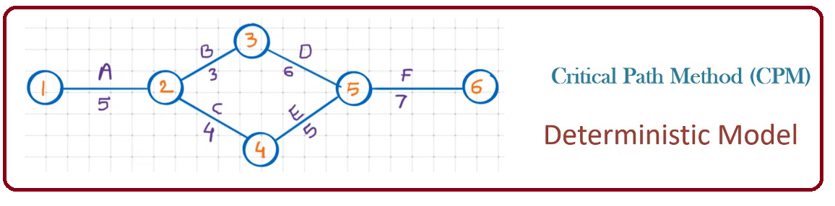
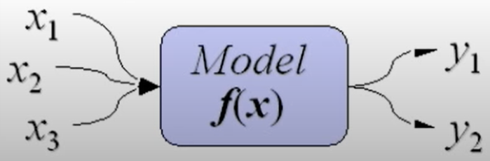
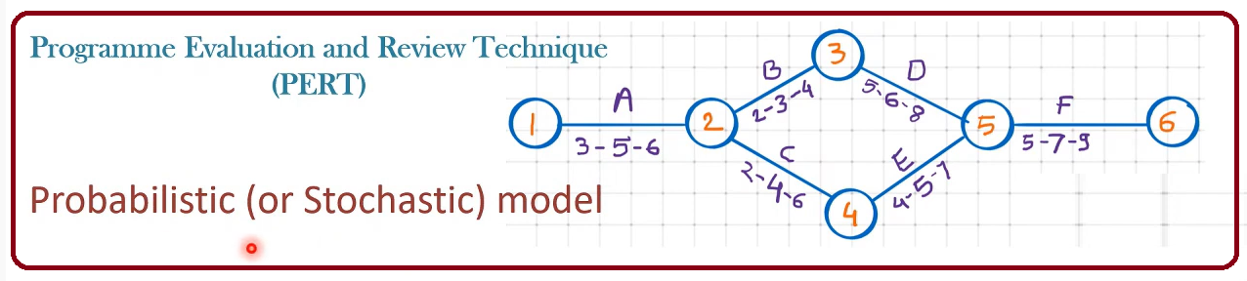




Deterministic Versus Probabilistic Model
Such models assume conditions of complete certainty and perfect knowledge.
Such models can assume different values with given probability.

Slide 7
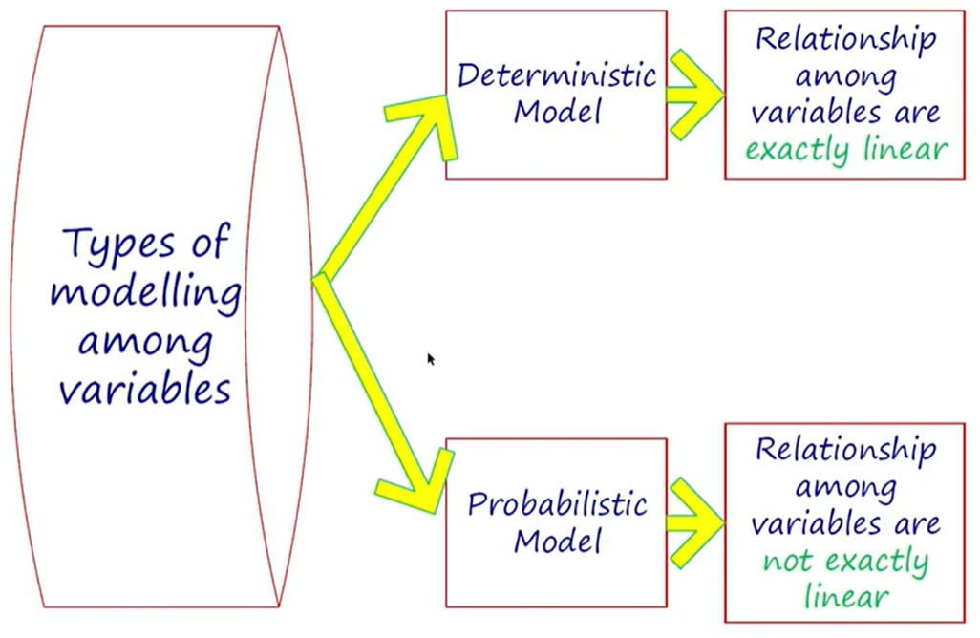
Deterministic Versus Probabilistic Model

Slide 8
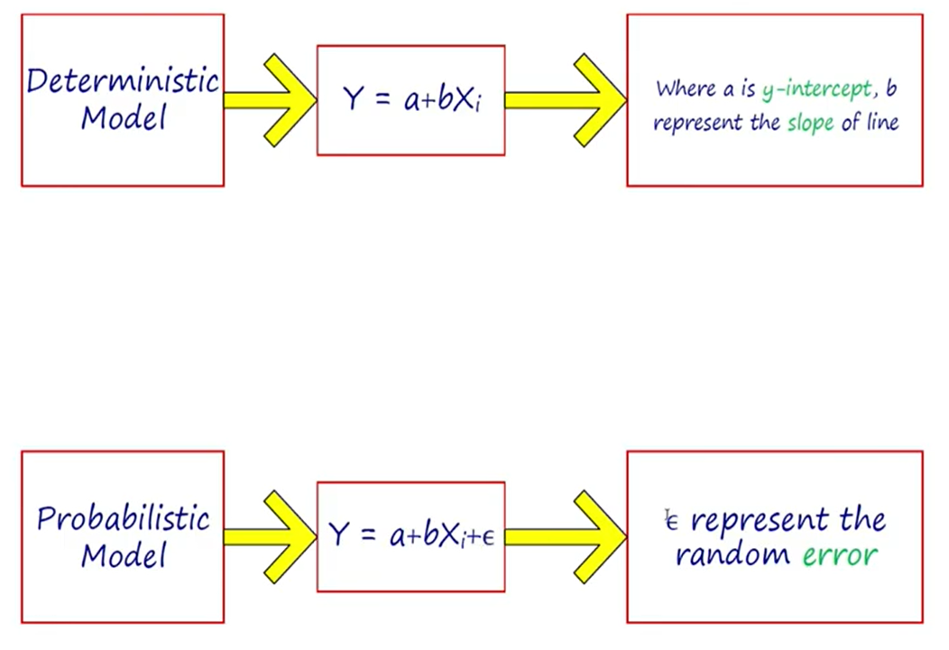

Deterministic Versus Probabilistic Model

Slide 9
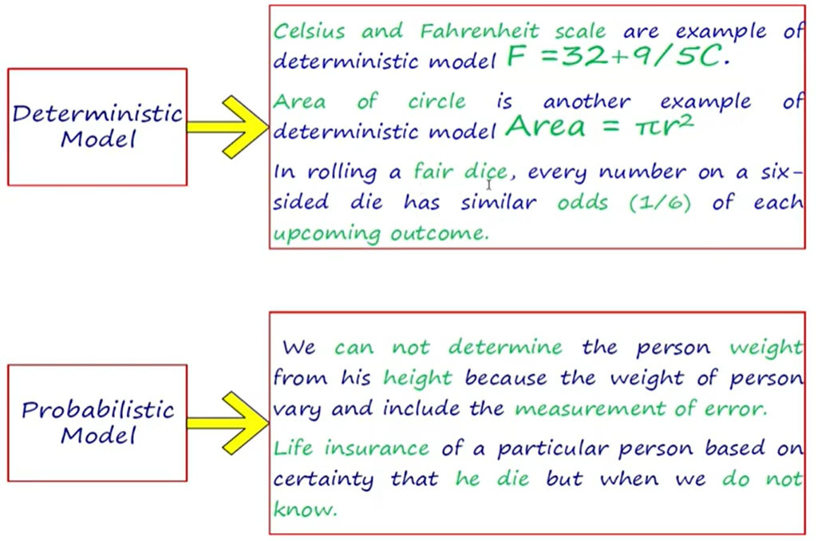












Deterministic Versus Probabilistic Model
Suppose 10 person height is 6 feet and weight should be 70 kg. It is not necessary every person having height 6 feet and its weight is 70 kg

Slide 10
Probability (Calculated Guess)
Probability is the branch of mathematics concerning numerical descriptions of how likely an event is to occur, or how likely it is that a proposition is true.
The probability of an event is a number between 0 and 1, where, roughly speaking, 0 indicates impossibility of the event and 1 indicates certainty.
The higher the probability of an event, the more likely it is that the event will occur. A simple example is the tossing of a fair (unbiased) coin.
Since the coin is fair, the two outcomes ("heads" and "tails") are both equally probable; the probability of "heads" equals the probability of "tails"; and since no other outcomes are possible, the probability of either "heads" or "tails" is 1/2 (which could also be written as 0.5 or 50%).

Slide 11

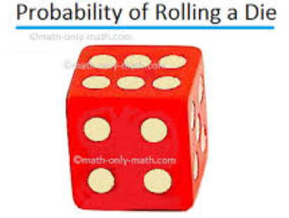


Observation or Measurement And Experiment or Random Experiment
Suppose a coin is tossed once and the up face is recorded. The recorded is called an observation or measurement.
The process of making observation is called an Experiment.
Tossing a coin, rolling a die and drawing a card from a deck are all examples of random experiments.

Slide 12
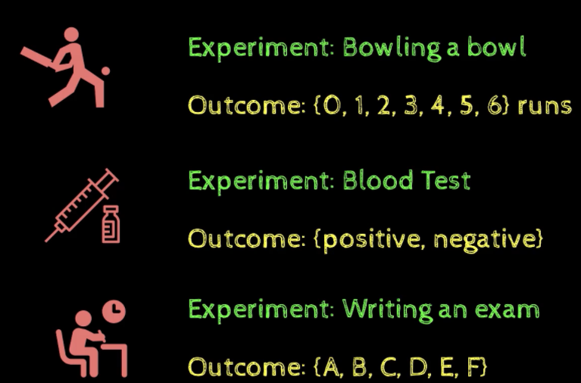


Experiment , Trial And Outcome
Experiment is any action, process or phenomenon whose result (outcome) is subject to uncertainty is called an Experiment.
Each repetition of an experiment is called as a Trial
An outcome is a result of an experiment is called Outcome.

Slide 13
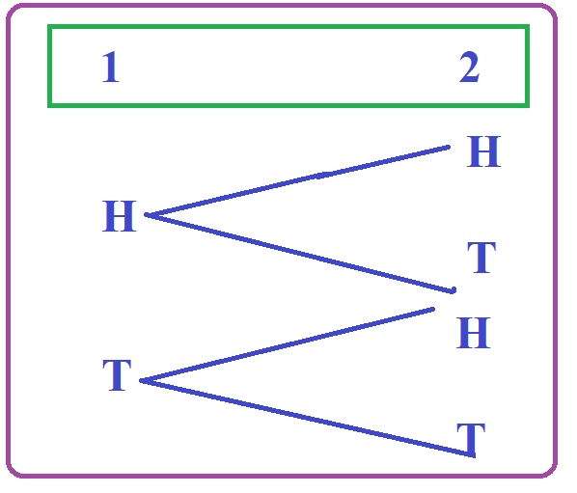
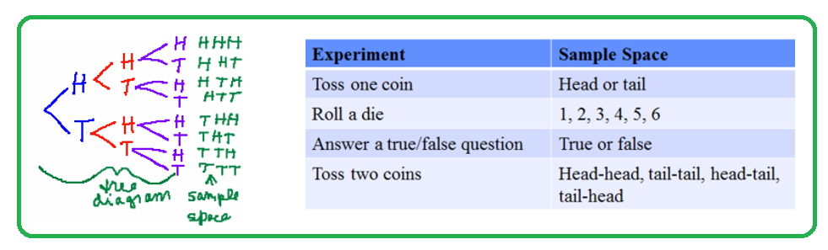












Sample Space
The sample space is the set of all possible outcomes in an experiment.
Example:
Tossing a coin: the sample space is {H, T}.
Tossing a two coin: the sample space is {HH, HT, TH, TT}
Rolling a Die : the sample space is {1,2,3,4,5,6}
S = {HH, HT, TH, TT}

Slide 14
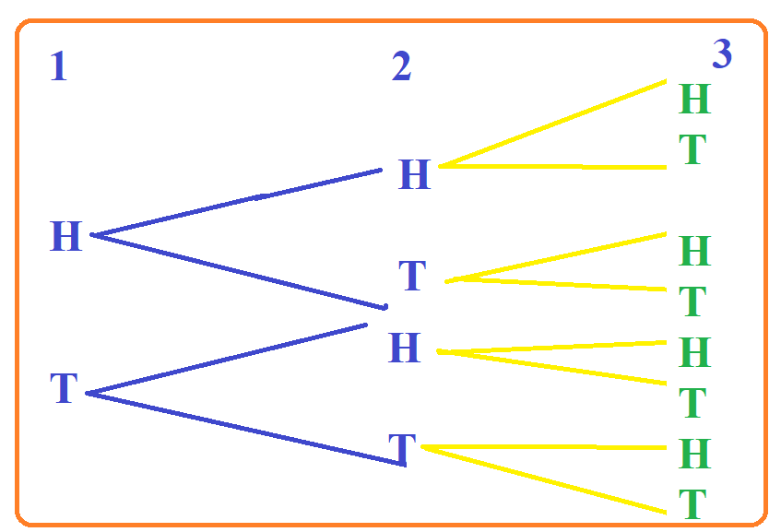















Example: Flip a coin 3 times. List the sample space.
S = {HHH, HHT, HTH, HTT, THH, THT, TTH,TTT}

Slide 15









Sample Space of 1 Kid in Line {Boy, Girl}
Sample Space of 2 Kids in Line {Boy Boy, Boy Girl, Girl Boy, Girl Girl }
Sample Space of 3 Kids in Line {BBB, …. GGG}
Formula of Sample Space = 2^{S}

Slide 16
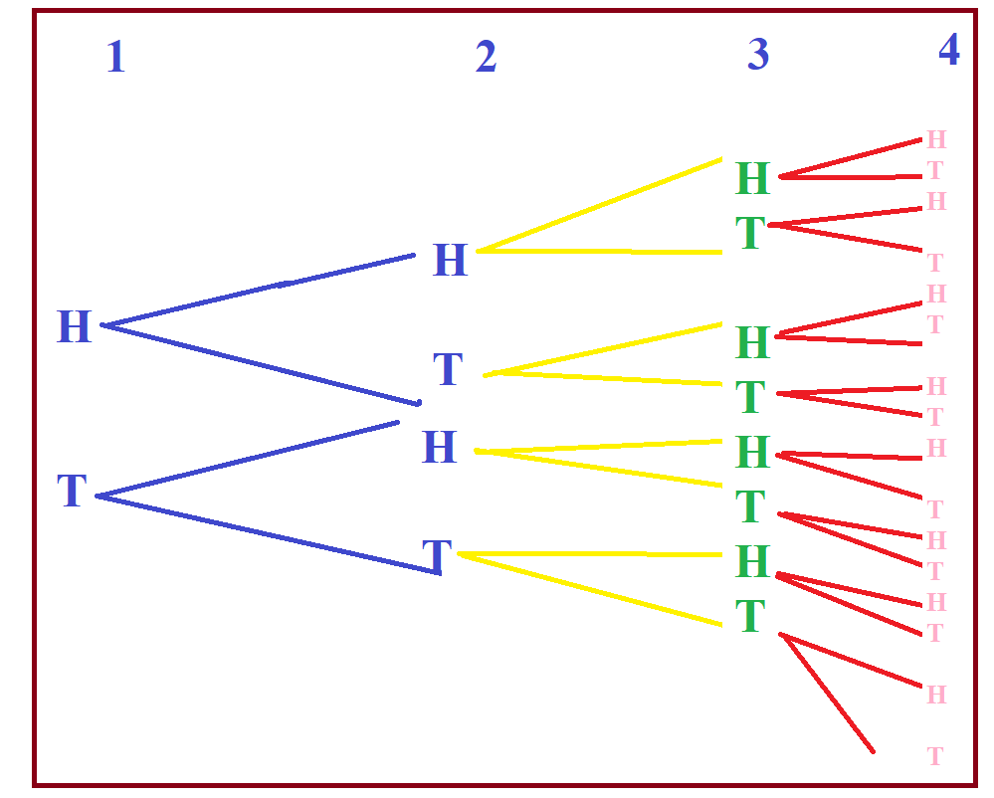
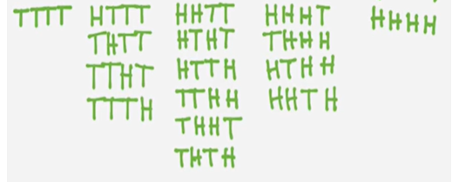
Example: Flip a coin 4 times. List the sample space.

Slide 17
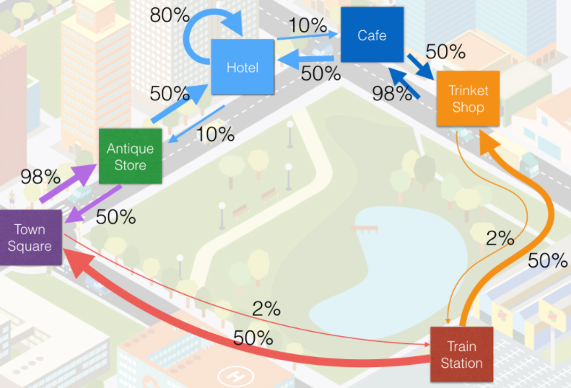
Markov Chain
Markov Chain is a random process in which the occurrence of future (next) state depends on the immediately (current) preceding sate it is known as Markov Chain Or Process
State: A state is a condition or location of an object in the system at specific or time is known as state.
Behavior of consumers in terms of their brand (state because check different brands) loyalty and switching pattern.
System = Market Place
Any Machine use to made or manufacture a product, we also sue Markov Chain.

Slide 18







































Slide 19




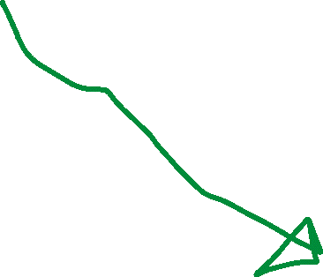



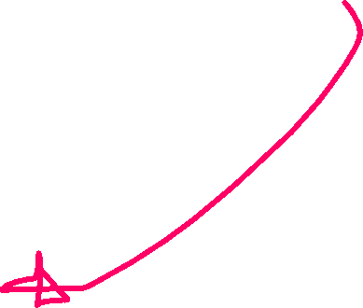




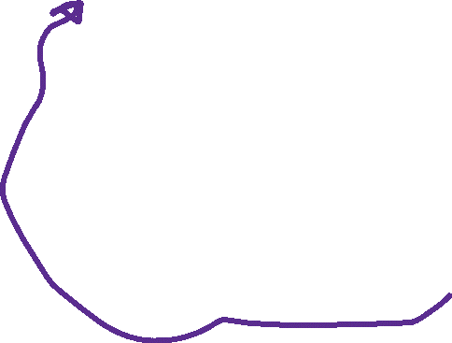






Slide 20














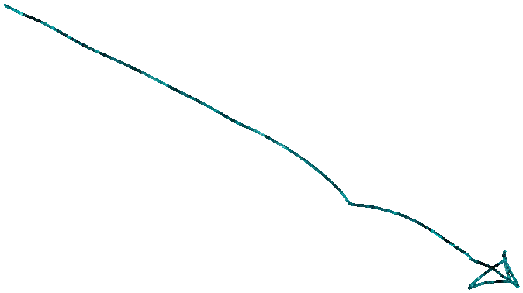








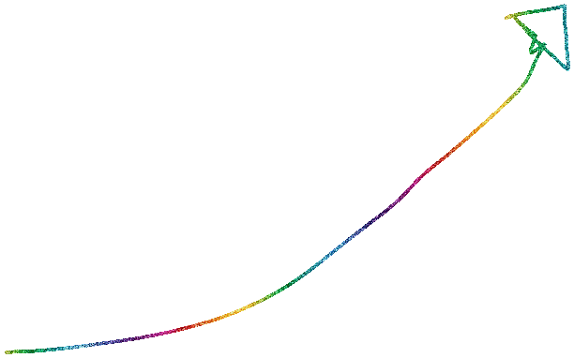





Slide 21
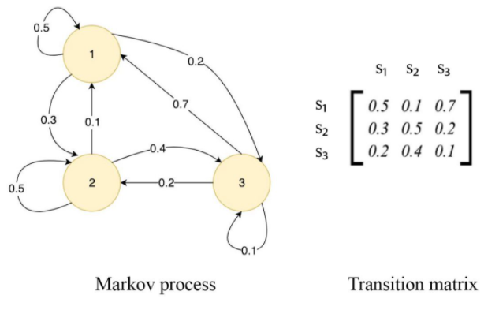
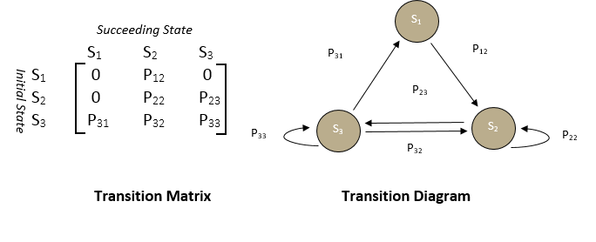
In Each state
Self Loop + Out arrow = 1, but not count incoming arrow

Slide 22
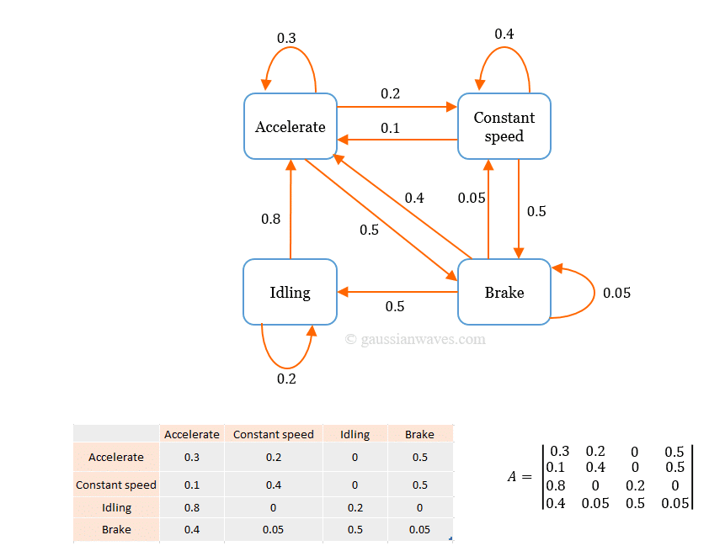
































In Each state
Self Loop + Out arrow = 1, but not count incoming arrow

Slide 23
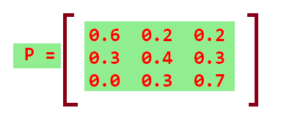
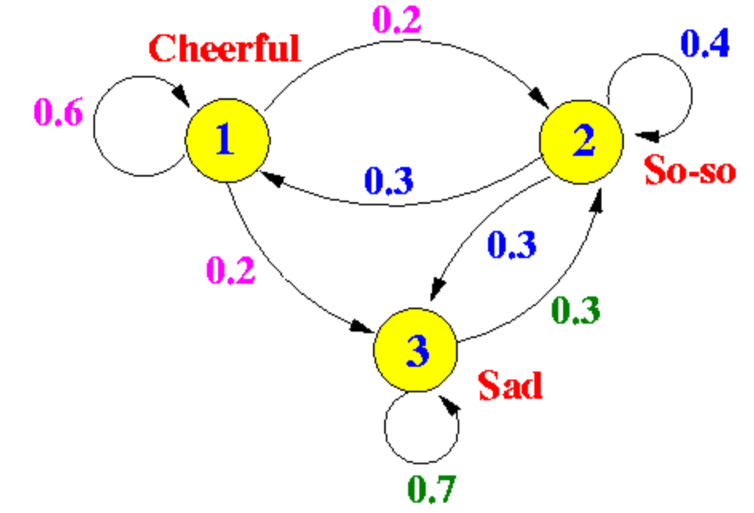


















In Each state
Self Loop + Out arrow = 1, but not count incoming arrow

Slide 24
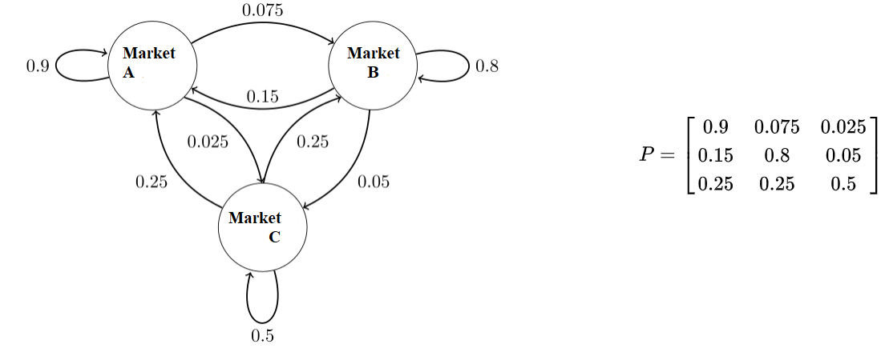







In Each state
Self Loop + Out arrow = 1, but not count incoming arrow

Slide 25

Stochastic Process

Slide 26
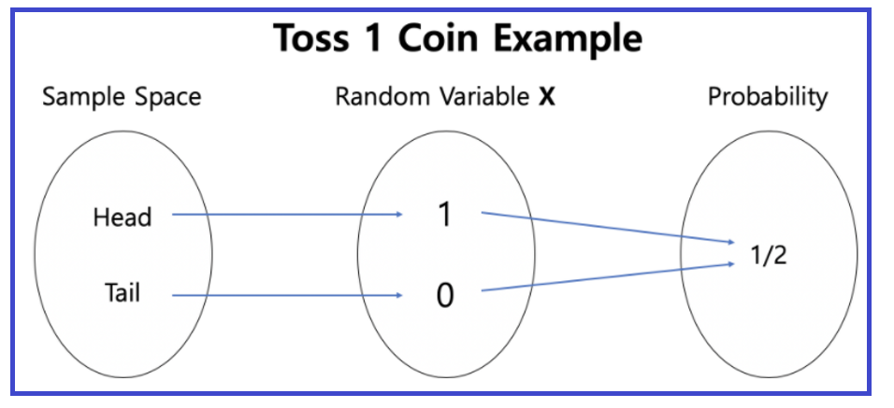
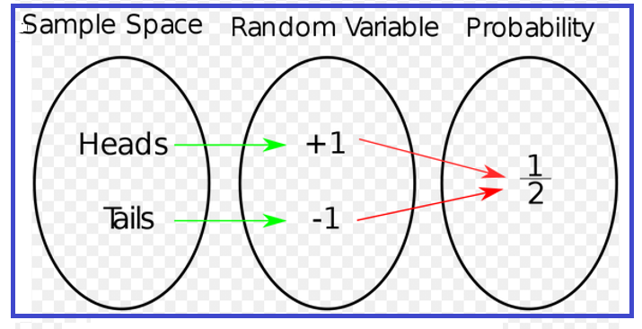
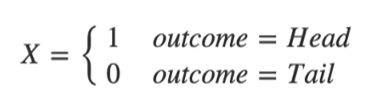
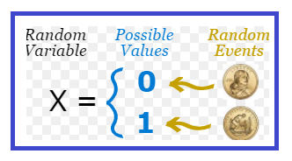









Random Variable
A Random Variable assigns a numerical value to the outcomes in the sample space of a random phenomena.
A Random Variable is a set of possible values from a random experiment. OR
It is a variable whose possible values are numerical outcomes of random phenomena.
It is denoted by capital X.

Slide 27
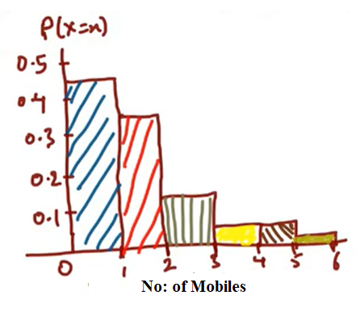









Q: Suppose a Company want to increase the sell of their Mobiles
No: of (X) Cell/Mobile Phones, X = Random Variable | Customers | Prob P(X=x), x=no: of values
1 | 450 | 450/1000 = 0.45
2 | 340 | 340/1000 = 0.34
3 | 110 | 110/1000 = 0.11
4 | 40 | 40/1000 = 0.04
5 | 40 | 40/1000 = 0.04
6 | 20 | 20/1000 = 0.02
Total | 1000 | 1
Q: What are the probability that out of 1000 customers buy more than 4 cell phones?
$P\left(X>4\right)=P\left(X=5\right)+P\left(X=6\right)=0.04+0.02=0.06$ = 1000* 0.06 = 60 customers
Q: What are the probability that out of 1000 customers buy more than 2 cell phones?
$P\left(X>2\right)=P\left(X=3\right)+P\left(X=4\right)+P\left(X=5\right)+P\left(X=6\right)=0.11+0.04+0.04+0.02=0.21$ = 1000* 0.21 = 210 customers
Q: What are the probability that out of 1000 customers buy more than 1 cell phones?
$P\left(X>1\right)=P\left(X=2\right)+P\left(X=3\right)+P\left(X=4\right)+P\left(X=5\right)+P\left(X=6\right)=0.34+0.11+0.04+0.04+0.02=0.55$ = 1000* 0.55 = 550 customers

Slide 28
Stochastic Process
Any process changes with respect to time is known as Stochastic Process.
Stochastic Process is a probabilistic type model, in which the current state of a process depend all its previous state.
It is a family of random variable
Uses:
To examine and predict the behavior of consumers in terms of their brand loyalty and switching patterns to other brands.
Usually constructed in terms of transition probabilities.
Used to study the stock market price movements

Slide 29
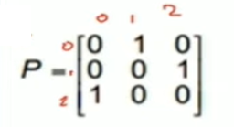
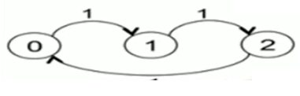
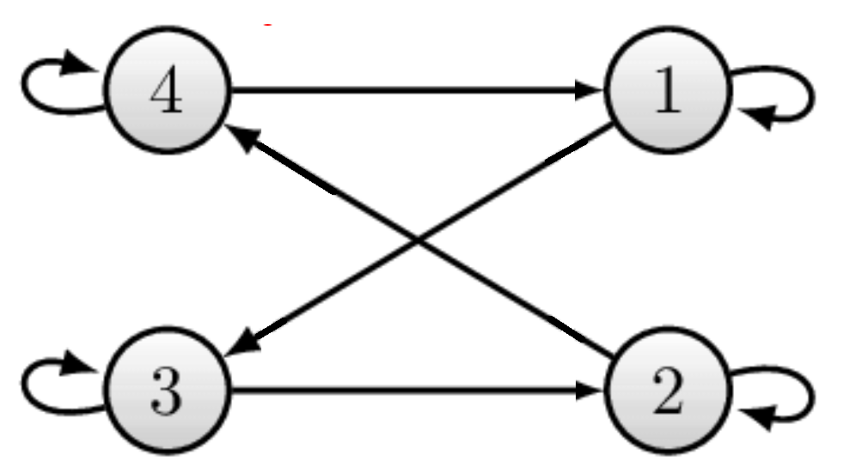



Irreducible And Not Irreducible Markov Chain
A Markov Chain is said to be irreducible if every state communicate with every other state, otherwise it is called as Not Irreducible.
Q: Check whether Markov Chain is Irreducible or Not Irreducible
Irreducible (original sate always
count as reachable)
C(0) = {0,1,2}
C(1) = {0,1,2}
C(2) = {0,1,2}
Irreducible (original sate always
count as reachable)
C(1) = {1,2,3,4}
C(2) = {1,2,3,4}
C(3) = {1,2,3,4}
C(4) = {1,2,3,4}

Slide 30
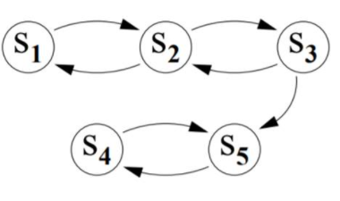
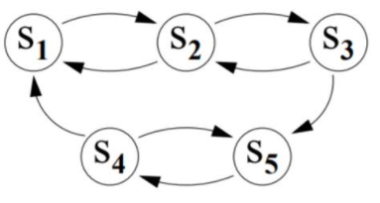




Irreducible And Not Irreducible Markov Chain
Q: Check whether Markov Chain is Irreducible or Not Irreducible
Not Irreducible (original sate always count as reachable)
C(S1) = {S1,S2,S3,S4,S5}
C(S2) = {S1,S2,S3,S4,S5}
C(S3) = {S1,S2,S3,S4,S5}
C(S4) = {S4,S5}
Irreducible (original sate always
count as reachable)
C(S1) = {S1,S2,S3,S4,S5}
C(S2) = {S1,S2,S3,S4,S5}
C(S3) = {S1,S2,S3,S4,S5}
C(S4) = {S1,S2,S3,S4,S5}
C(S5) = {S1,S2,S3,S4,S5}

Slide 31
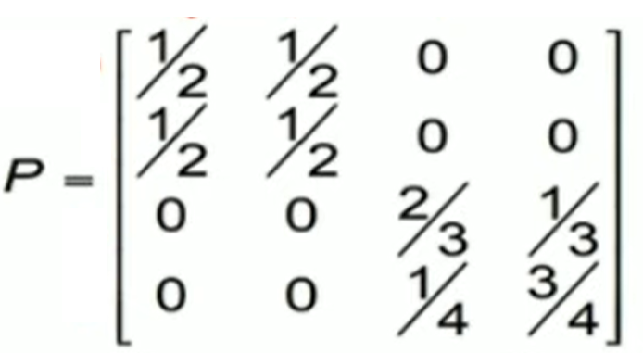
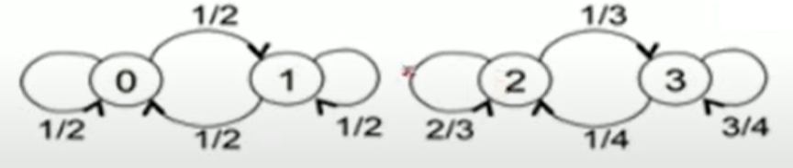

Irreducible And Not Irreducible Markov Chain
Q: Check whether Markov Chain is Irreducible or Not Irreducible

Slide 32
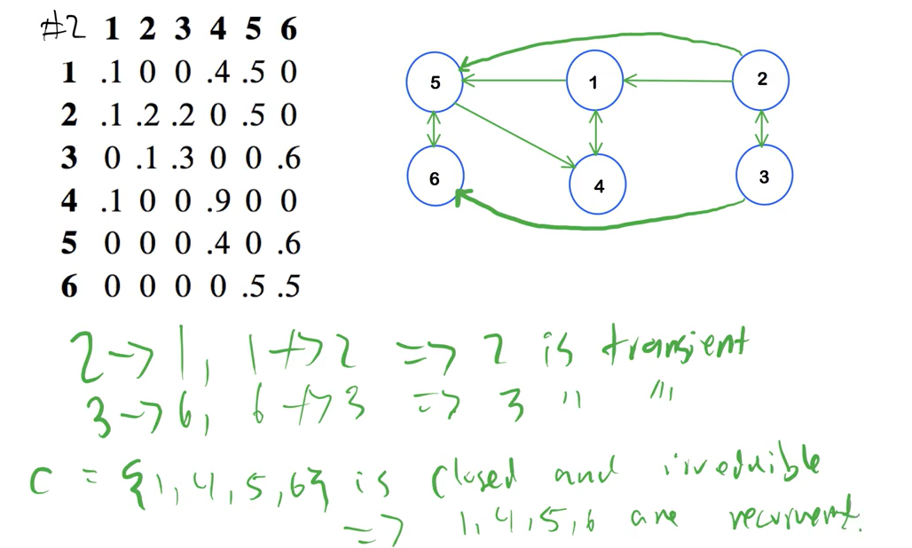
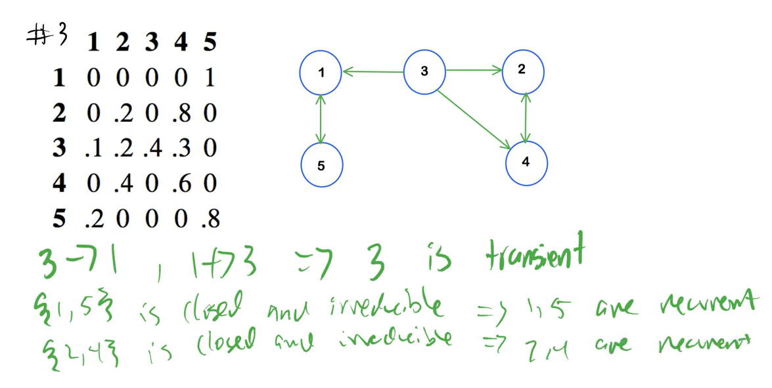






Recurrent State of Markov Chain
A recurrent state is a state for which whatever the transitions you make there is always a path to go back to that initial state, otherwise it is a transient state.

Slide 33
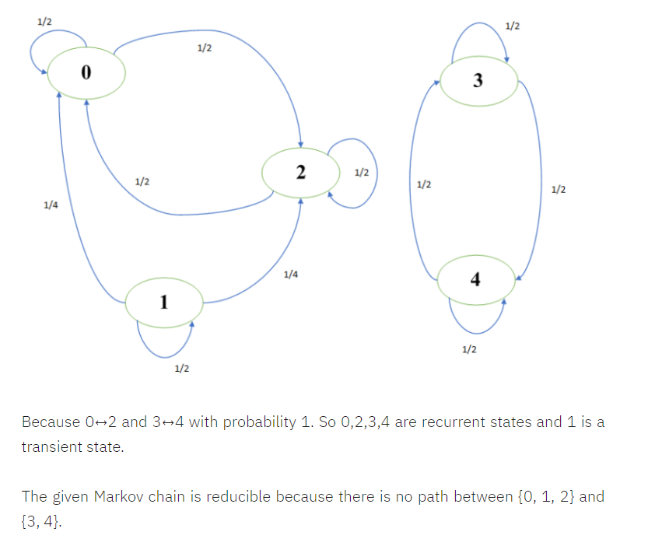



Recurrent State of Markov Chain
A recurrent state is a state for which whatever the transitions you make there is always a path to go back to that initial state, otherwise it is a transient state.

Slide 34
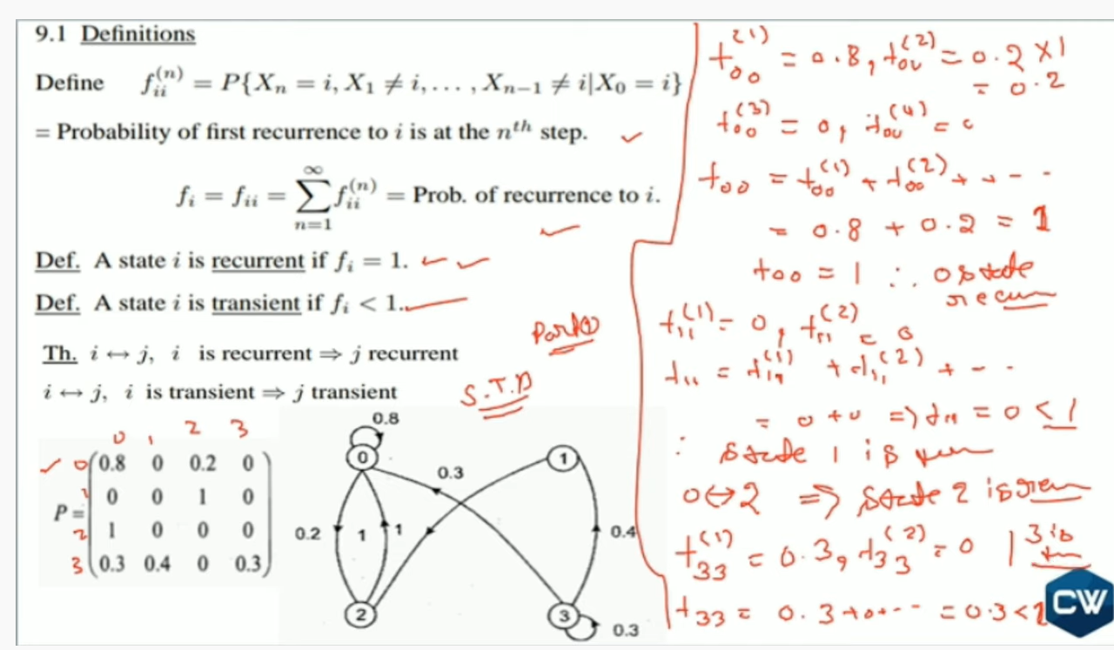
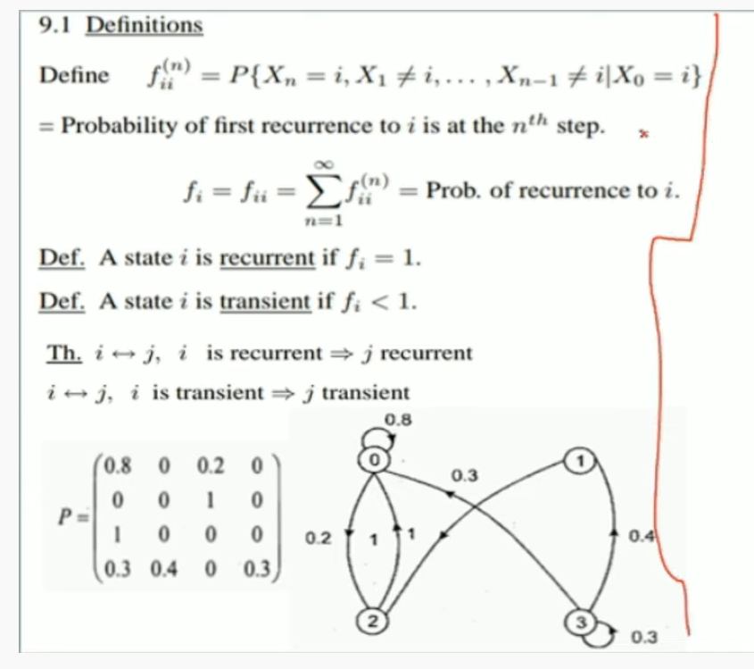

Slide 35
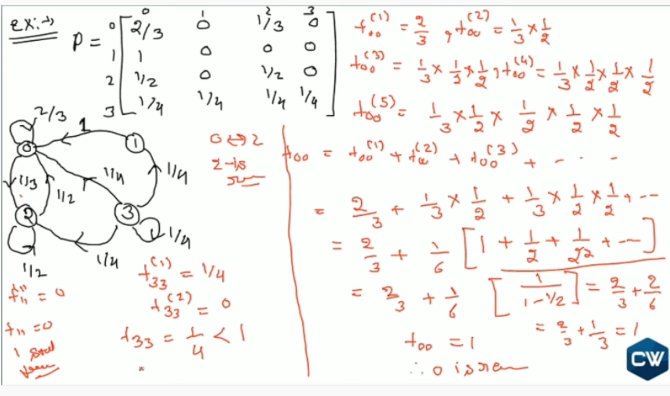

Slide 36
Queuing Theory

Slide 37
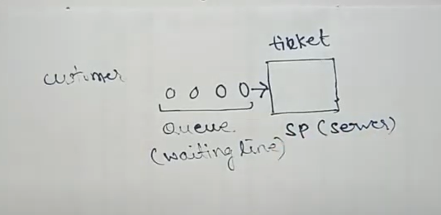
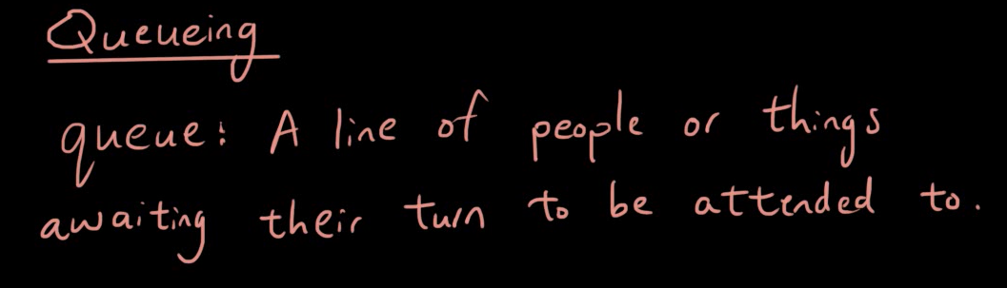
customer

Slide 38
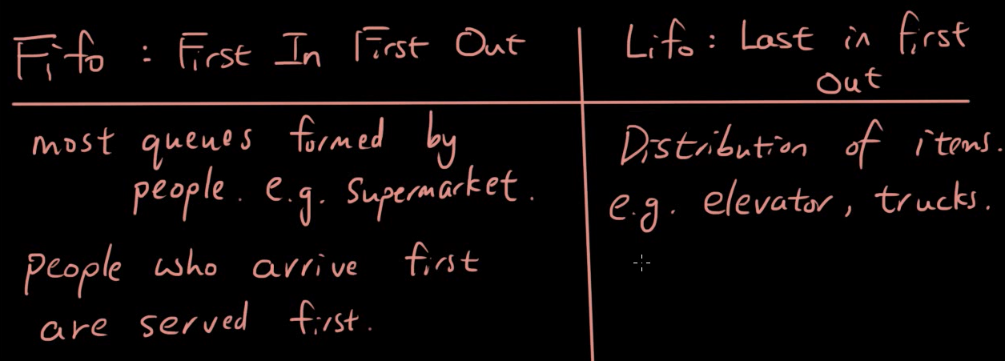

Slide 39
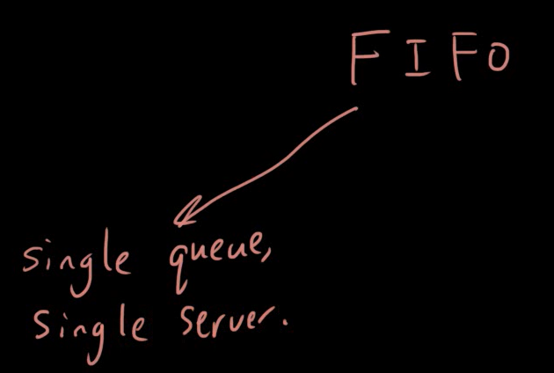
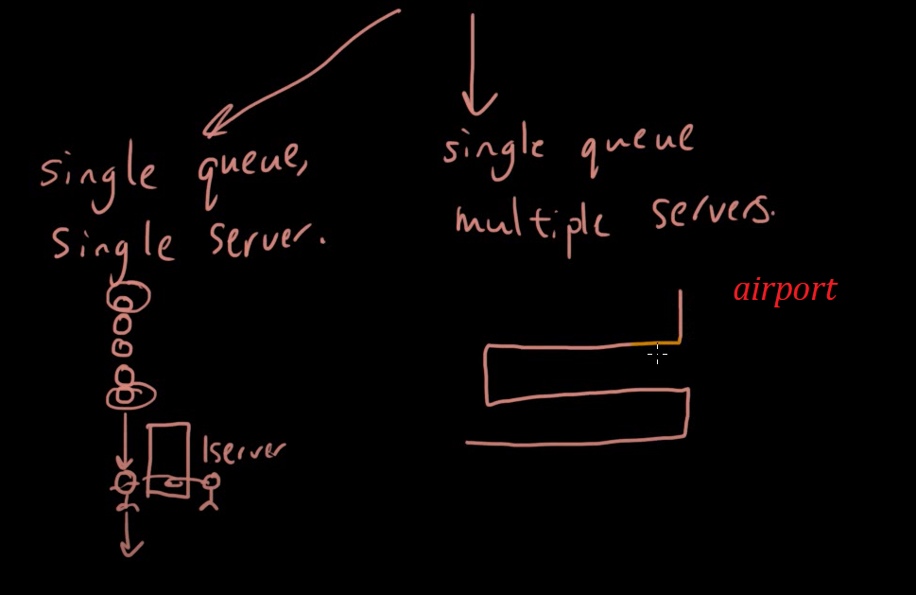
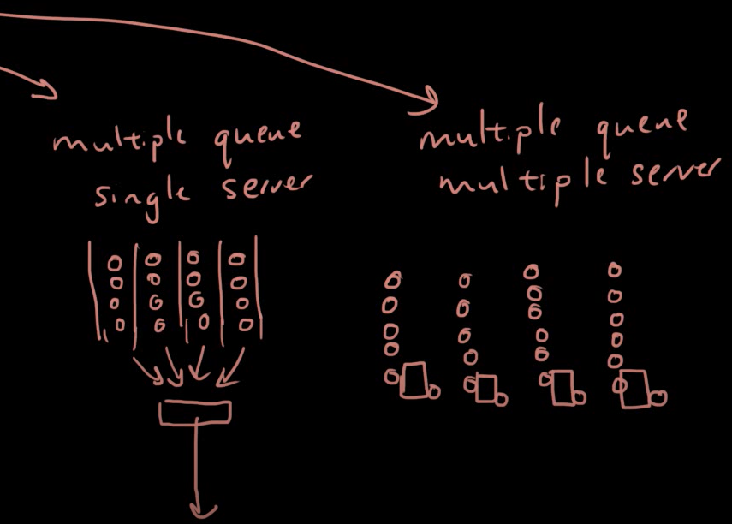

Slide 40
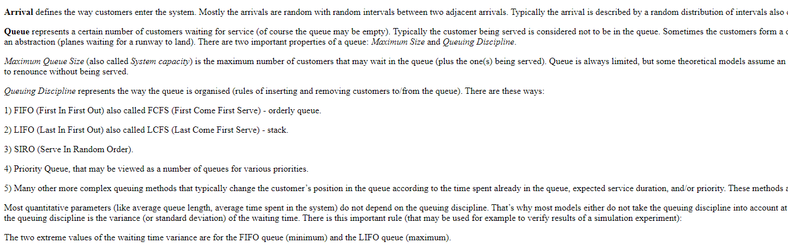

Slide 41


Traveeling Salesman Proble

Slide 42


Slide 43


Slide 44

There are three major components of Queuing system (1) Customers (2) Queue (3) Service facility.
First of all customer arrive.
More than one customer arrive to create a line than it is called as Queue or waiting line.
Servers are available and to provide service to customer, than such process is known as Service facility.
Queue and service facility is the part of system.
Customer avail service and out from the system is known as customers departure

Slide 45


In Queue does not count customers that being served
Suppose 3 people in line and 2 in the front of cashier
So queue has only 3 customers

Slide 46


Slide 47
Arrival distribution represents the customers arrival into your system.

Slide 48
What is Queuing Theory?
Queuing Theory is a mathematical study of waiting lines, using models to show results, and show opportunities, within arrival, service and departure processes.

Slide 49


Slide 50


Slide 51





Slide 52


Slide 53
Queue: Queue is a line of people or vehicles waiting for something. OR Waiting line is called Queue.
Arrival: 1 Person, Machine, Part, etc. that arrives and demands service is called an Arrival.
Queue Discipline: Rules for determining the order that arrivesls receive service.
Channel: Number of servers is called Channel.
Phase: Number of steps in service is called as Phase.

Slide 54
THE END

